Slide 1

Automated Waste sorting system using Yolo and FLASK Project Category: RESEARCH
Guide Name Student Name & Registration Number
`
Dr. A.JACKULIN MAHARIBA KOUSHIK VISHAL S(RA2211026010384)
KISHORE KHANNAN(RA2211026010409)

Slide 2
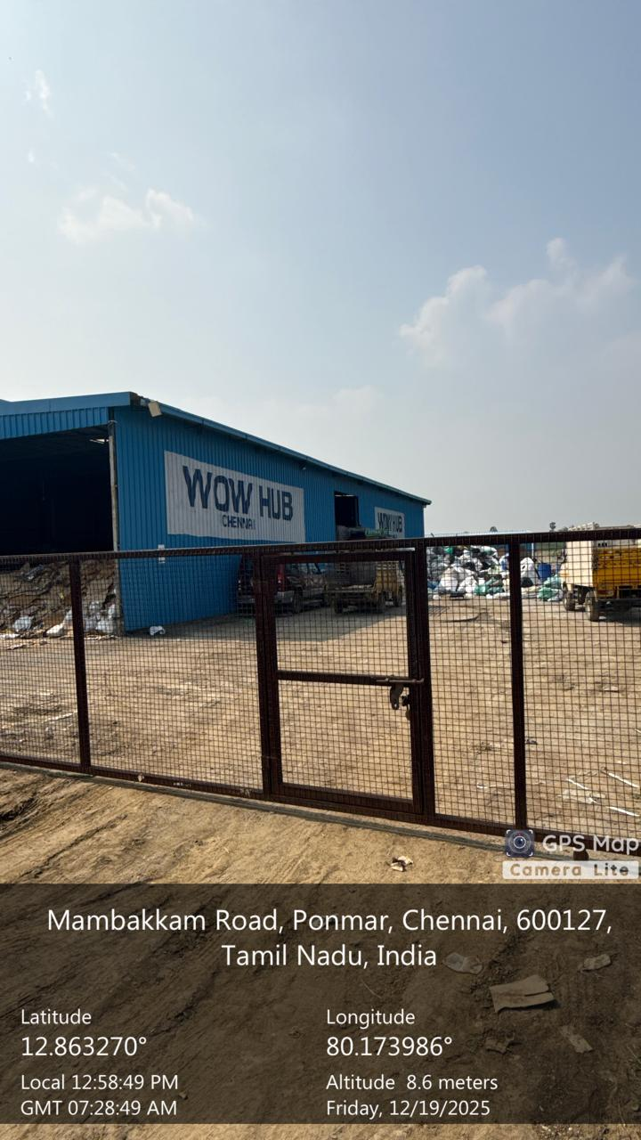
Visit to Recycling centres
As part of our major project, we visited a local recycling center to understand how waste segregation and recycling are currently carried out. This field study helped us observe real-time waste handling, storage, and manual sorting processes, which inspired the need for an automated waste sorting system using computer vision.
Centre Name : WOW HUB, Chennai
Objectives
•To understand the existing waste segregation and recycling process
•To observe manual and semi-automated waste sorting techniques
•To analyze real-time challenges in handling mixed waste
•To collect practical insights and images for project implementation
•To identify areas where AI-based automation can improve efficiency

Slide 3
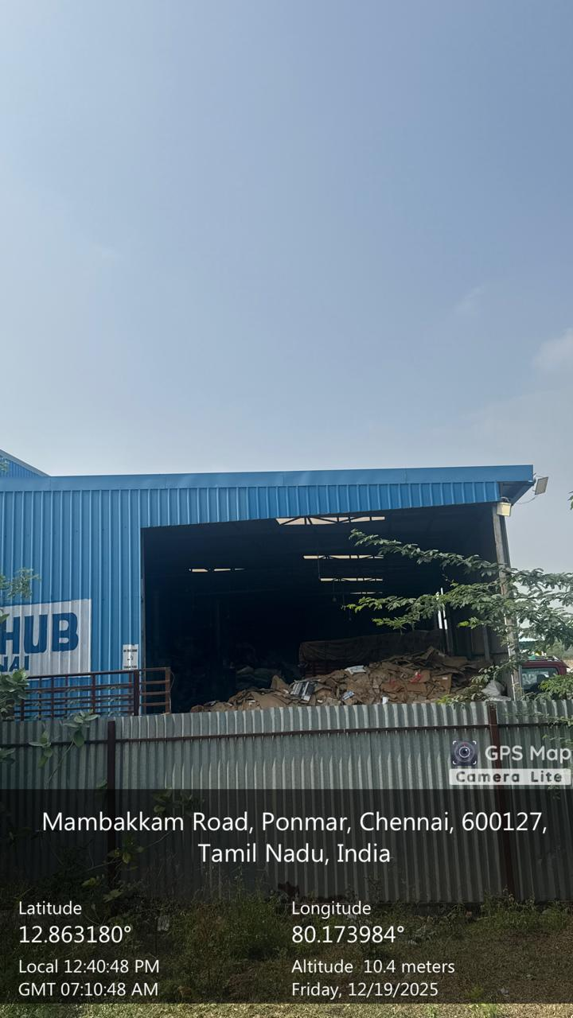
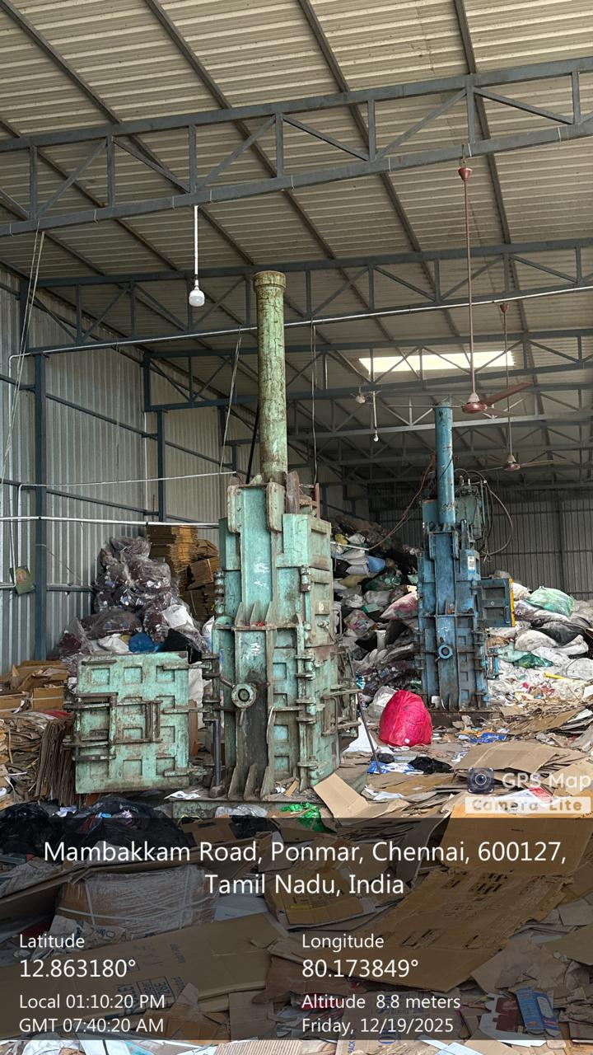
This image shows the bulk waste collection and storage area inside the recycling center located at Mambakkam Road, Ponmar, Chennai. The collected waste, mainly consisting of cardboard and paper materials, is stored in large quantities within a covered industrial shed.At this stage, waste is accumulated from multiple sources before segregation and further processing. The waste is not automatically classified and requires manual inspection to separate recyclable materials. This bulk storage approach helps in handling large volumes but increases dependency on human effort for sorting.
This image shows the waste pre-processing area inside the recycling center, where collected waste materials such as cardboard, plastic, and mixed recyclables are handled before further recycling. The machines visible in the image are hydraulic baling or compression machines used to compact waste into dense bundles.Waste is first manually segregated and then fed into these machines to reduce volume for easier storage and transportation. This process improves space utilization but still relies heavily on manual identification and feeding of waste materials.

Slide 4
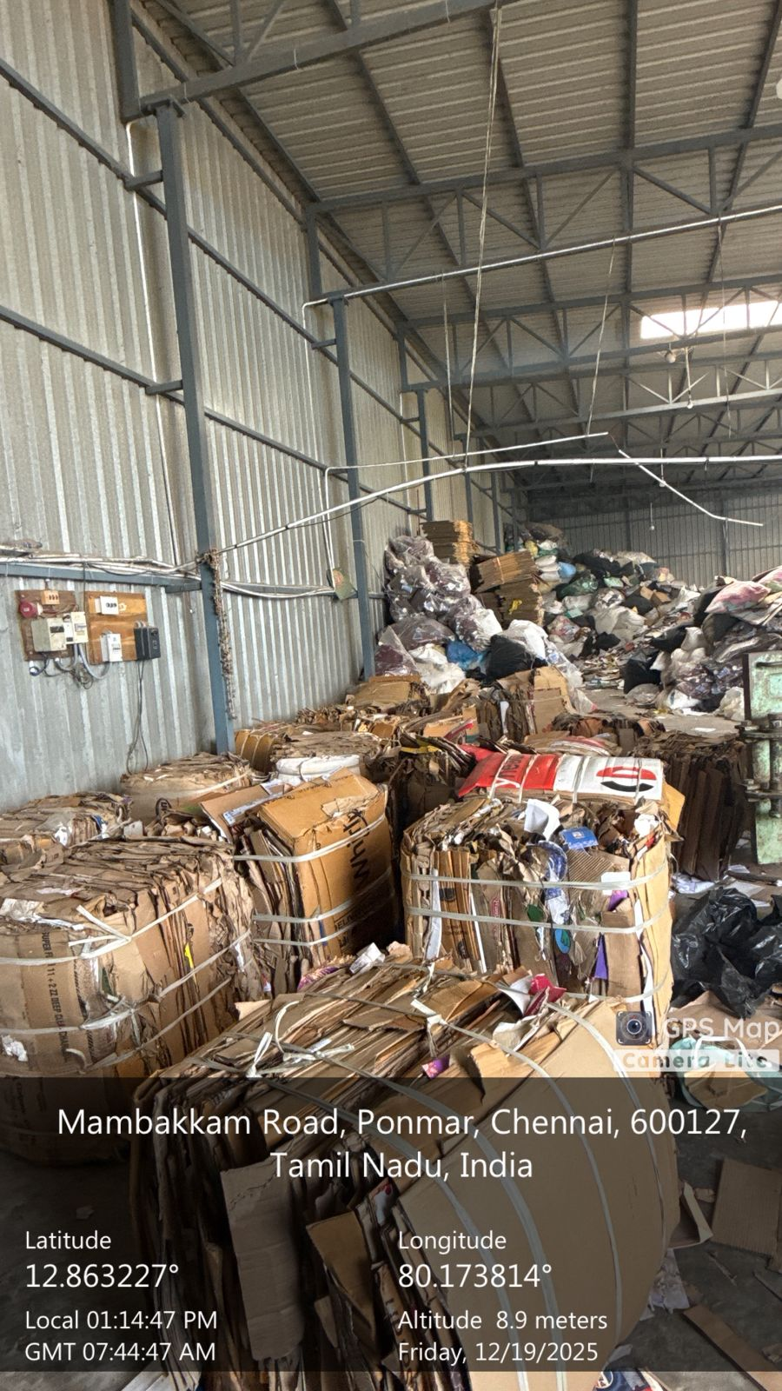
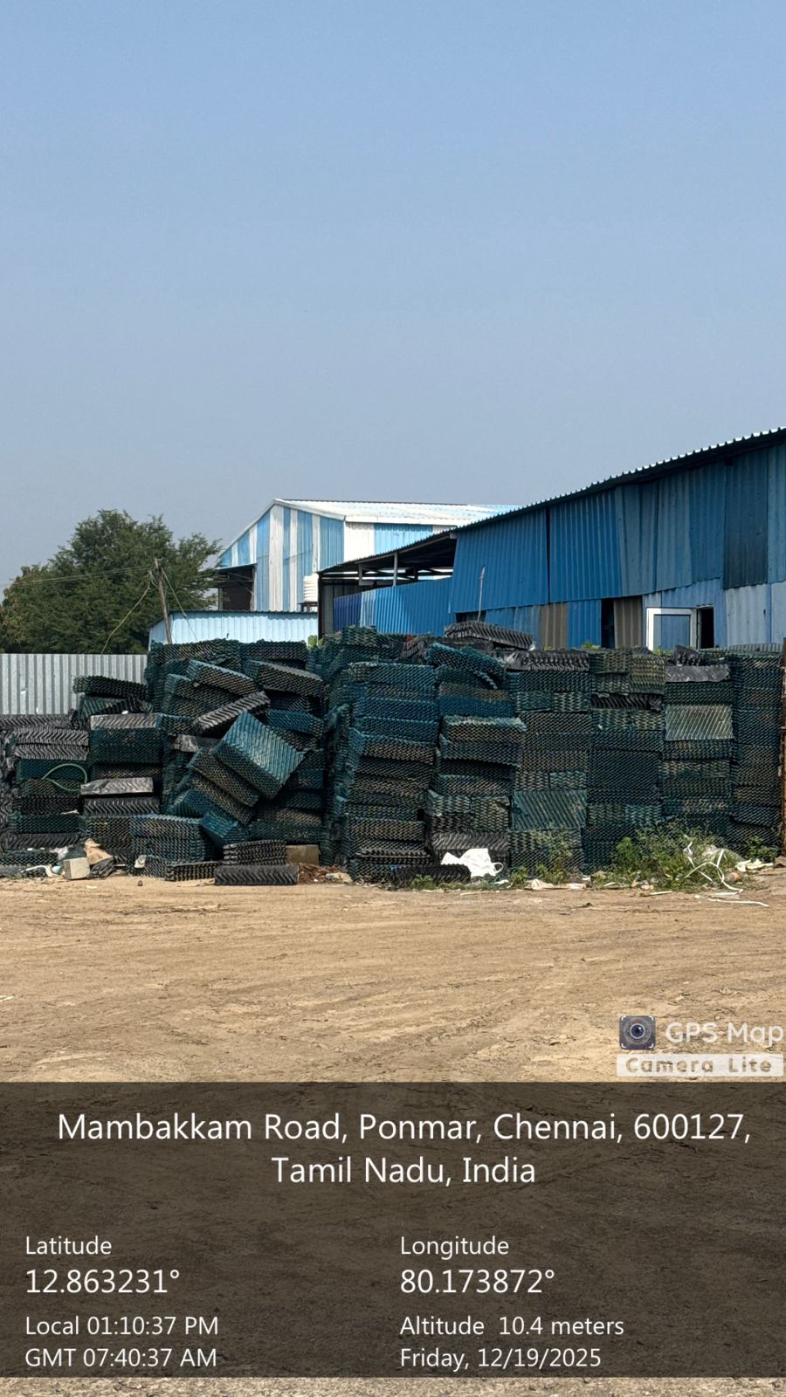
This image shows the segregated and compressed waste storage area inside the recycling facility. After manual sorting and compression, recyclable materials mainly cardboard and paper are tightly packed into bundles using baling machines and stored separately.These compressed bundles are arranged systematically to optimize storage space and prepare the material for transportation to recycling units. Although the waste is segregated at this stage, the process still depends on manual identification and handling, which limits efficiency and scalability.
This image shows the outdoor storage area of the recycling center where sorted plastic waste materials are stacked in large quantities. After segregation and initial processing, plastic components are arranged and stored separately based on type and structure.Proper segregation at this stage is essential to ensure high-quality recycling and to prevent contamination with other waste materials. The storage is organized but still depends on manual identification during earlier stages.

Slide 5
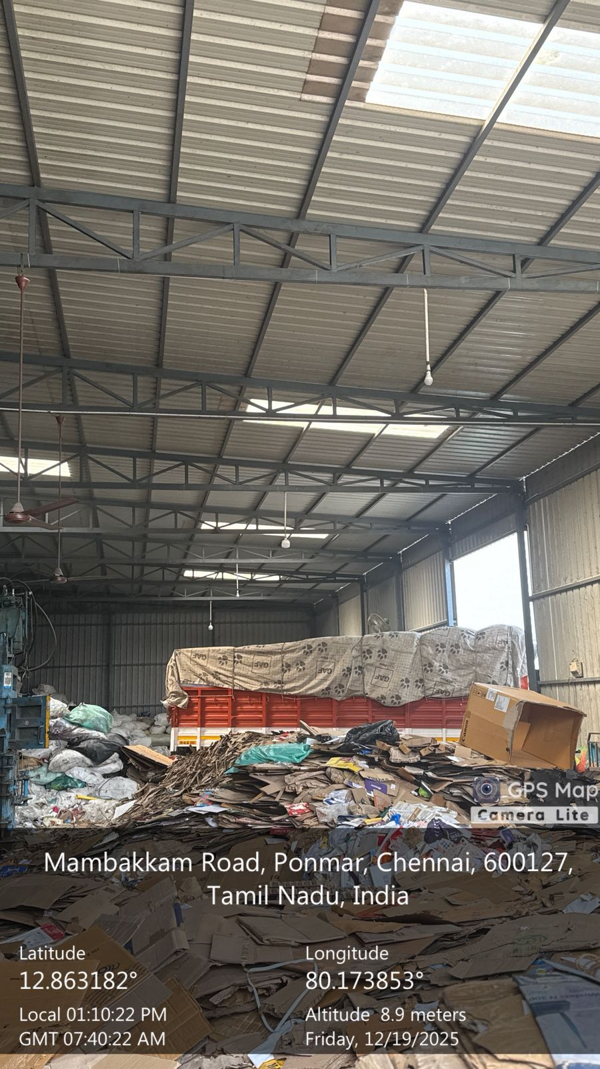
This image shows the stage where segregated waste materials, mainly cardboard and paper waste, are prepared for transportation. The waste is collected, loosely sorted, and loaded near transport vehicles inside the recycling facility.At this stage, waste is temporarily stored before being dispatched to specialized recycling plants for further processing. Manual handling and visual inspection are used to ensure the waste type is appropriate for transportation.

Slide 6
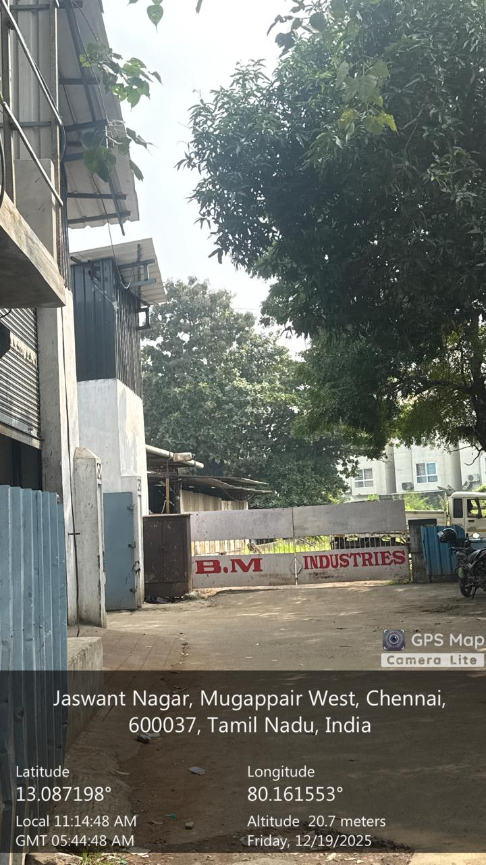
Centre name : B.M Industires
This image was captured during our visit to BM Industries, Mugappair West, Chennai, a functional recycling and waste management facility. The visit provided practical exposure to real-world waste handling and segregation practices currently followed in recycling industries.
Obejectives:
•Waste is collected from various sources and brought to the facility in mixed form
•Primary segregation is largely performed manually by workers
•Sorting efficiency depends on human accuracy and experience
•There is minimal use of intelligent automation in waste classification

Slide 7
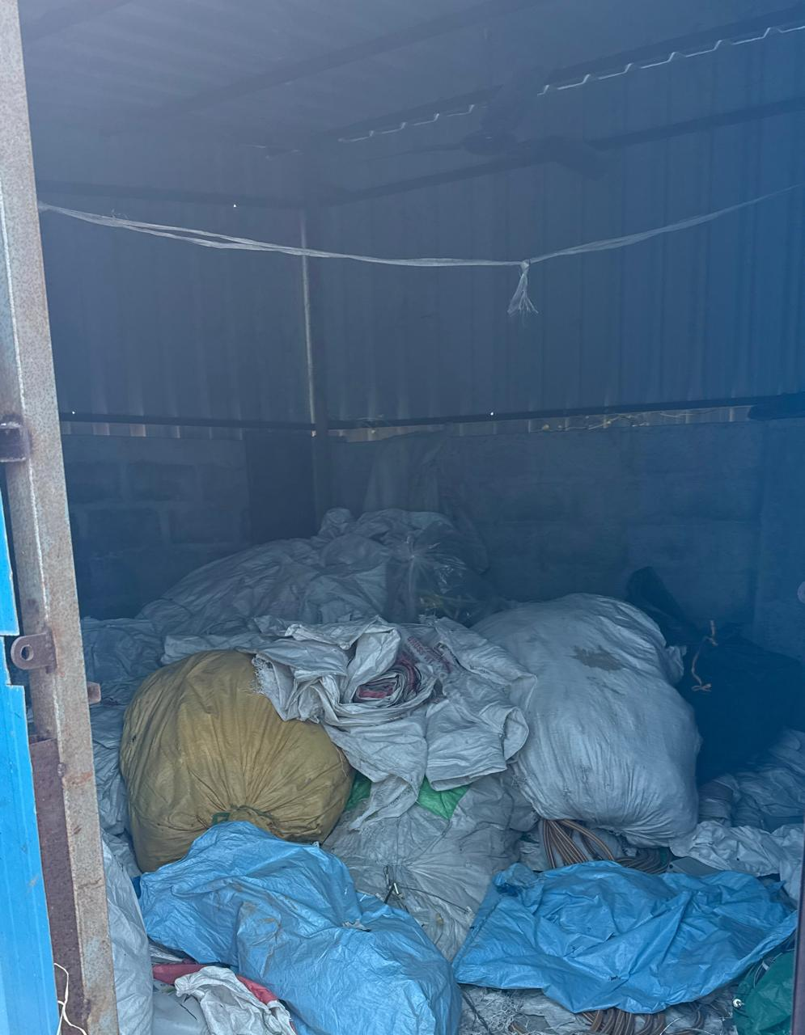
The observations from this recycling center clearly demonstrated the limitations of manual waste sorting, such as time consumption, inconsistency, and labor dependency. These challenges directly motivated the development of our proposed Automated Waste Sorting and Recycling System using YOLO, where computer vision is used to identify and classify waste types automatically. The Django-based backend will manage system data, monitoring, and reporting, making the solution scalable and efficient. Visiting BM Industries helped us validate the real-world necessity of AI-driven automation in waste management. The insights gained from this visit were instrumental in shaping our project design and aligning it with practical industry requirements.

Slide 8
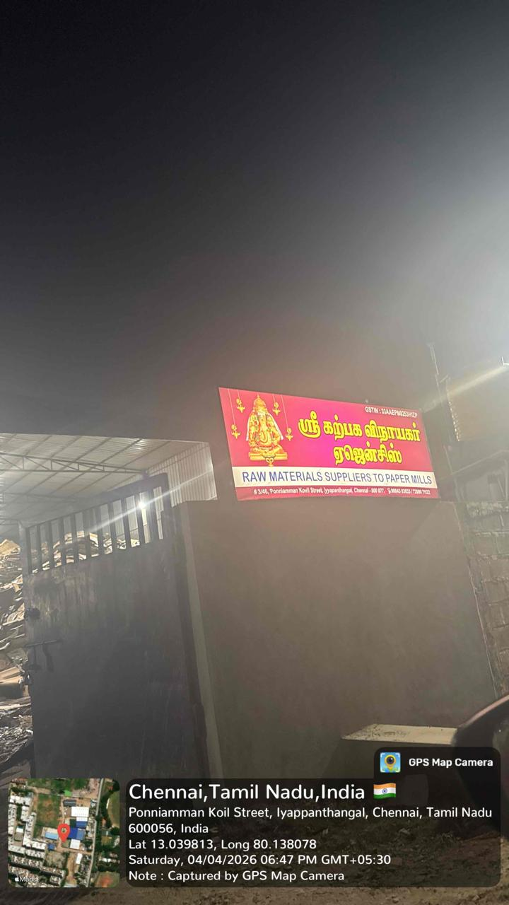
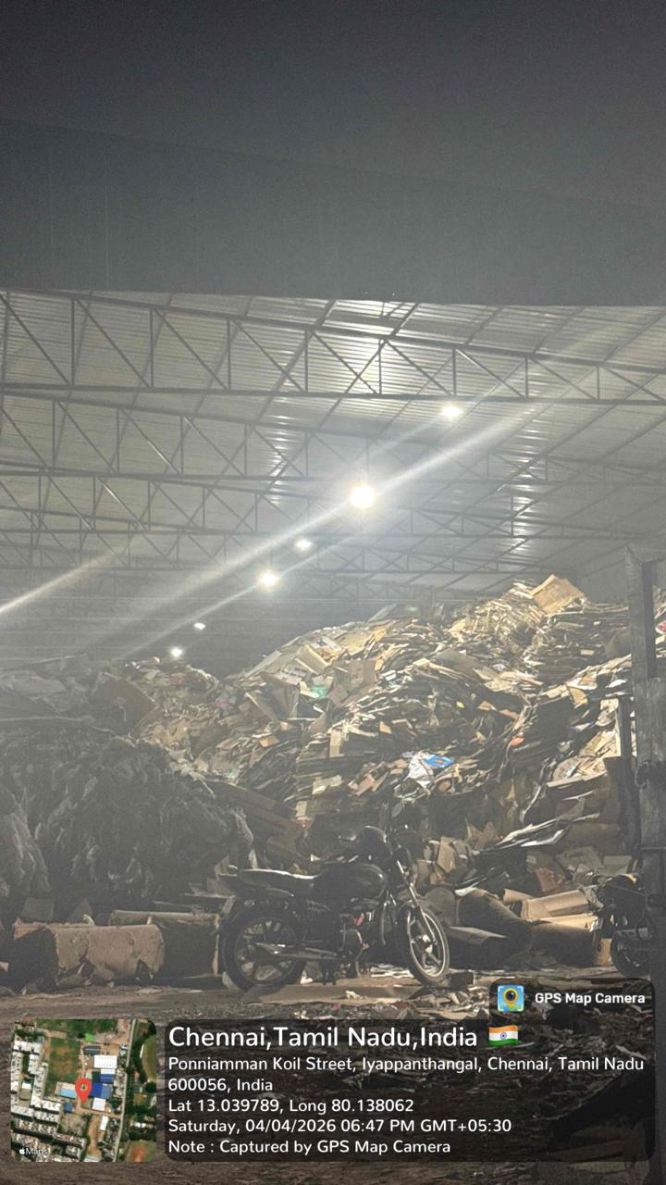

Slide 9
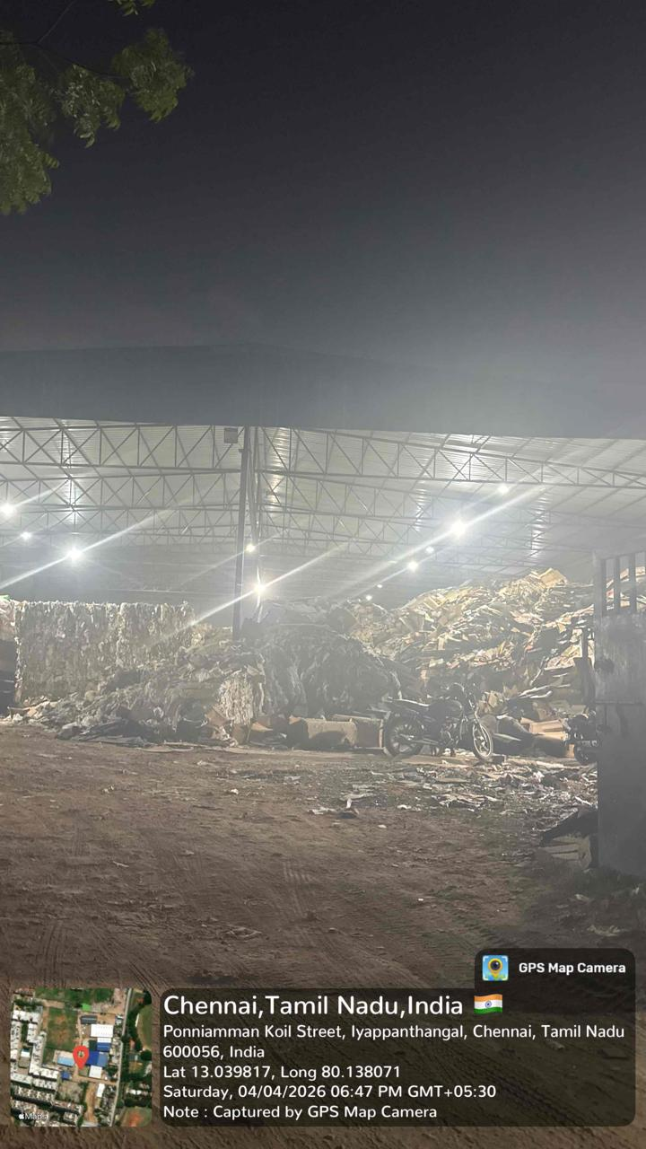
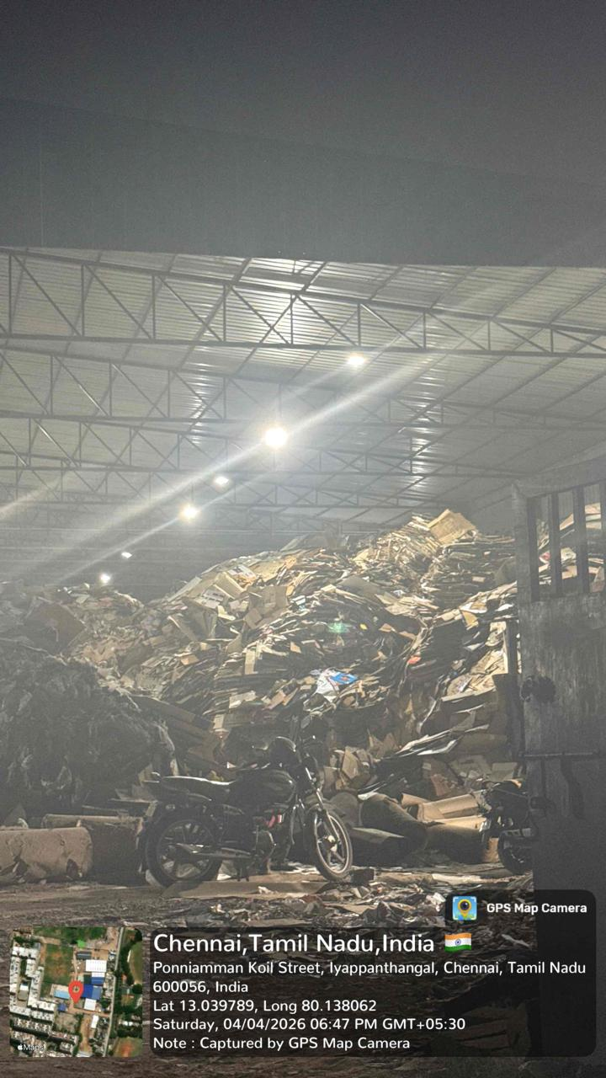

Slide 10
Importance
The visit to the recycling center played a crucial role in shaping our major project on the Automated Waste Sorting and Recycling System. By observing real-time waste handling processes such as bulk collection, manual segregation, compression, storage, and transportation, we gained practical insights into the limitations of the existing system.The field study highlighted key challenges including high dependency on manual labor, time-consuming sorting processes, risk of human error, and inefficiencies in handling large volumes of waste. These observations strongly justified the need for an automated, intelligent waste sorting solution.Based on these learnings, we propose an AI-based system using YOLO for real-time waste detection and classification, along with Django for backend data management and monitoring. The practical exposure from this visit ensured that our proposed system is realistic, industry-relevant, and capable of addressing real-world waste management challenges effectively.

Slide 11
THANK YOU

